Slide 1
Chinese Power Equipment Manufacturing
Promote China-Arab Energy Collaboration
November 6th, 2018
Shanghai Electric Group Co., Ltd.

Slide 2
Shanghai Electric : One-stop solution provider
with high flexibility
World-leading manufacturer
Equipment Supply
EPC Turnkey
Reliable and experienced international contractor
Flexible turnkey scope
Complete supply chain for power generation projects
O&M services
Services
Project Financing
Equity involvement + EPC
Financing arrangement
Access to multiple financing channels
LTSA/FRAME

Slide 3
Our Capability
36GW
Annual Production Capacity
60
Manufacturing Base
112 units 1000MW class ordered, 45 commissioned
263 units 600MW class ordered, 173commissioned
373 units 300MW class ordered, 337commissioned
20+
Years experiences as EPC contractor in global market
92GW
Total Capacity of provided turnkey solution globally
40GW
Total Capacity of provided EPC services
No.100
All Sectors
Source: SE project database 2016

Slide 4
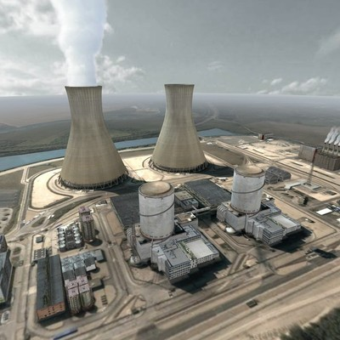
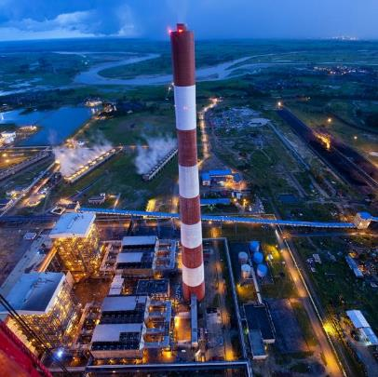
Highlight of China Domestic Power Market
Total Capacity of Coal fired power in 2016
950 million kilo watt
Total Capacity Assumption in 2020
1.1 billion kilo watt
Total Electric Power Production in 2017
6495.1 billion kilowatt-hour
In which, Thermal Power Production
4662.7 billion kilowatt-hour

Slide 5
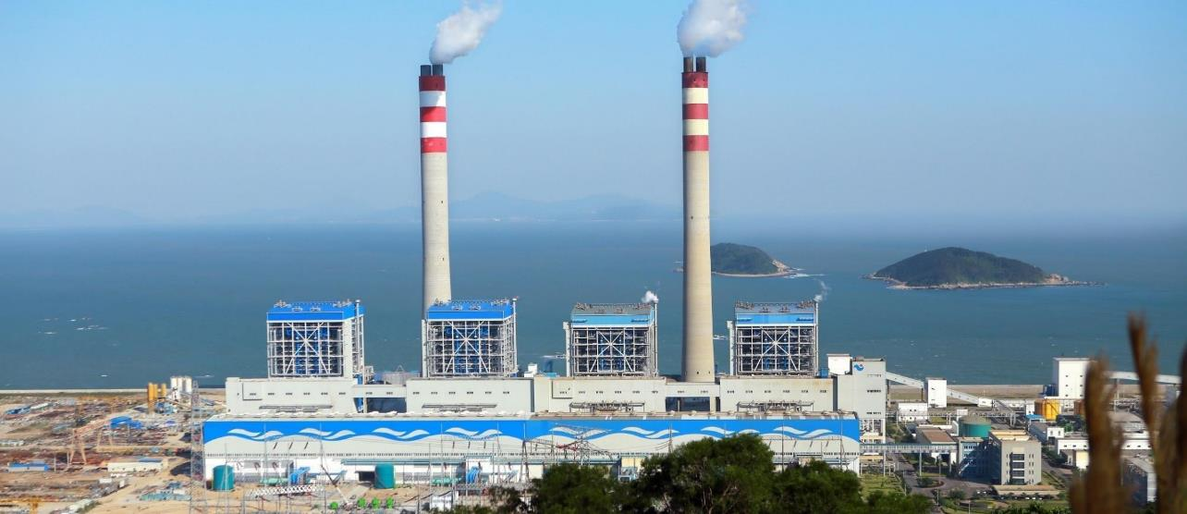
Project Case: World’s Biggest Coal Fired Units
Yangxi Thermal Power Plant Phase I & II
Client:
Guangdong Yangxi Power Company
Capacity & Fuel:
P1: 4×600MW Coal fired
P2: 2×1240MW Coal fired
COD:
P1: December, 2009
P2: Under Construction
Location:
China
Phase II: 2x1240MW
World’s Biggest Coal Fired Units
SOURCE: SECPG’s project database

Slide 6
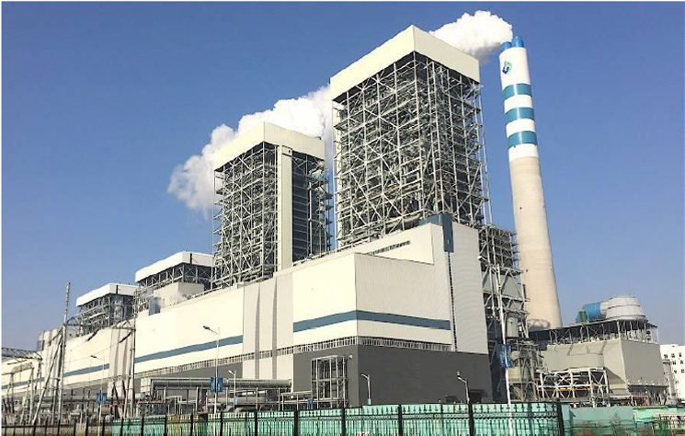
Project Case: Advanced Technology
Taizhou Power Plant #3, 1000MW
First 1000MW DRH (Double Reheat)
Plant efficiency: 47.82%
Coal consumption: 256.8g/kwh
Highest Parameter & Best Efficiency CFPP in the world

Slide 7
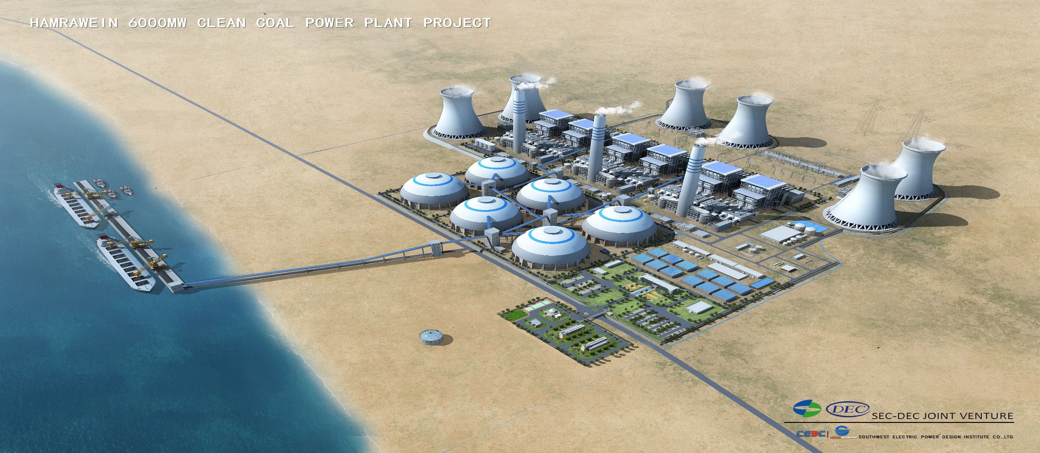
Project Case: Cooperation in Egypt
Hamrawein 6600MW Clean Coal Fired Power Project
Client:
Egyptian Electricity Holding Company
Capacity & Fuel:
6x1100MW USC Coal fired
COD:
NTP: 2019.12 (Expected)
Unit 1: NTP+52 months
Unit 2: NTP+58 months
Unit 3: NTP+64 months
Unit 4: NTP+70 months
Unit 5: NTP+76 months
Unit 6: NTP+82 months
Location:
Red sea governorate, Egypt
Biggest coal fired power plant in history

Slide 8
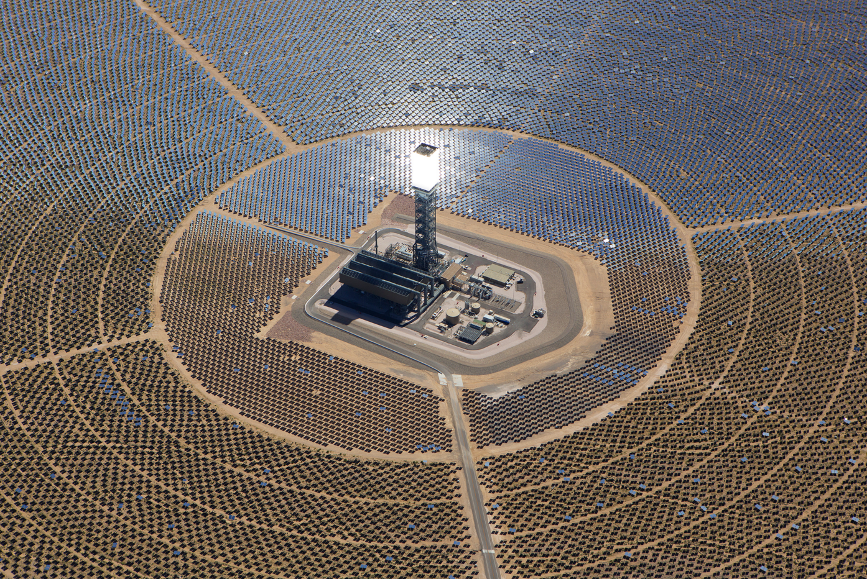
Project Case: Concentrated Solar Power (CSP)
Dubai CSP Power Plant Phase IV
Client:
Dubai Electricity and Water Authority (DEWA)
ACWA Power
Capacity & Fuel:
700MW CSP + 133MW PV
Estimated COD:
Unit 1 April 2020
Location:
Dubai, UAE

Slide 9
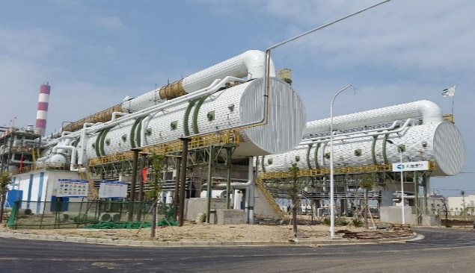
Project Case: Other Fields – Water Treatment
Seawater Desalination
MED/RO Experience in the World
Qinhuangdao, Hebei
MED- 6000 t/d
Huilai, Guangdong
RO - 10080 t/d
Huanghua Ⅲ, Hebei
MED - 25000 t/d
PCPC, Philippine
RO - 2640 t/d
VINH TAN, Viet Nam
RO - 9600 t/d
Huanghua Ⅱ, Hebei
MED- 12500 t/d
Wassit, Irap
Boiler Feed water - 4800 t/d
Baosteel, Zhanjiang
MED - 30000 t/d, EPC
- Largest Intergrated MED Manufacture in China
- First ten thousand ton MED Project in China(2008)
- First MED EPC Project in China(2013)
- First oversea MED Project(2014)
Aden, Yemen
MED - 2160 t/d
Boiler Make-up Water
Puerto Princesa, Indonesia
RO - 7680 t/d
Balingian, Malaysia
Industrial Effluent - 6240 t/d
Desalted Water - 3312 t/d
PMB, Brunei
MED - 37500 t/d
Medan, Indonesia
RO - 6552 t/d
SOURCE: SECPG
MED
RO

Slide 10
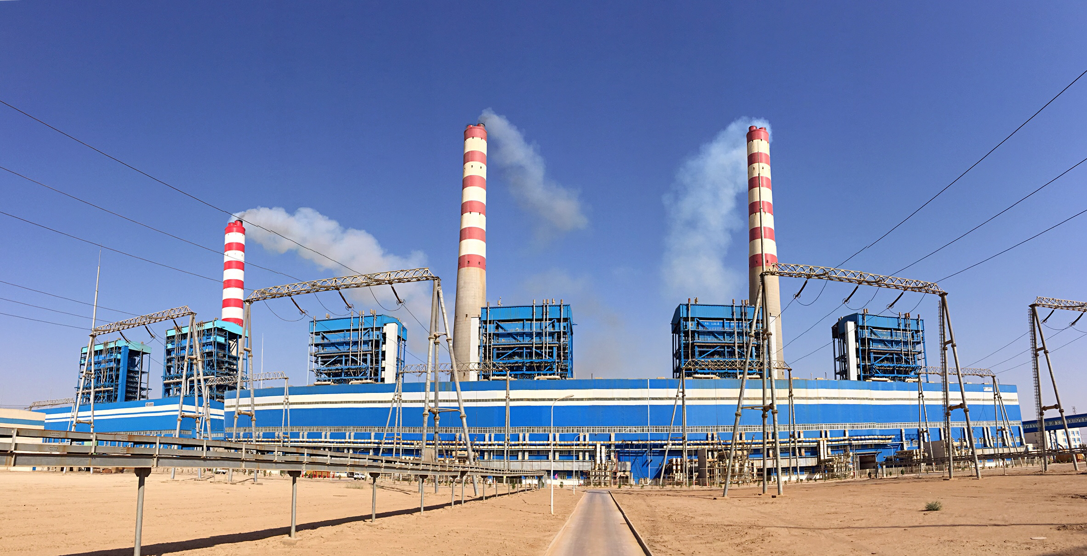
Project Case: Other Fields – Operation & Maintenance
Wassit Thermal Power Plant Phase I & II
Client:
Ministry of Electricity of Iraq
Capacity & Fuel:
P1: 4×330MW Oil fired
P2: 2 X610MW
COD:
Unit 1: August, 2013
Unit 2: June, 2013
Unit 3: December, 2013
Unit 4: April, 2014
Unit 5: June, 2015
Unit 6: June, 2015
Location:
Iraq
Wassit Power Plant supplies 85% of Power of Bagdad, 30% of Iraq
SOURCE: SECPG’s project database

